Slide 1
Getting Ready for Breakout Groups
In order to place you in groups for the breakout session please “rename” yourself in Zoom by:
Scrolling to the top right-hand corner of your participant box, click on the three dots.
Select “rename” and a number in front of your name that corresponds to the size of district you are in.
0 = I want clarification on guidance
1 = I want to talk about completing the blueprint
F = Regional Advisor/Facilitator
Your zoom name would look something like this: 0 Krista Parent, COSA
You will then be placed into breakout sessions based on this input.

Slide 2
Ready Schools, Safe Learners
GUIDANCE FOR SCHOOL YEAR 2020-21
June 10, 2020
Series 3
6-23-2020

Slide 3
Notes:
This will take time to learn for adults and especially for children. Be patient, read and plan, listen to families and your community, and seek support when needed. No one is expected to know all parts of this guidance or how it will shape and unfold in each school. The job of your partners, COSA, ODE, ESDs are to support you as you strive to safely bring students back to campuses.

Slide 4
AGENDA
Orientation to Guidance & Grounding your Thinking
Safety and Balancing Risk
Developing your building plan
Communicable Disease Management Plan
Daily log requirement
Physical Distancing
Cohorting
Entry, Screening & Arrival and Departure
Transportation & Meal Service
Communication & Training
Model Selection
Review Models
Breakouts

Slide 5
Participant Workbook
Located in the chat box is a link to the “Participant Workbook.”
Please navigate to the workbook and download or print it for reference throughout the training:
https://docs.google.com/document/d/1Y2YuzgwQLFCY0x8ZY2832yueCRTTeAjotjVeAOU-K4Y/edit?usp=sharing
There will also be opportunities at the end of each section to take notes, reflect, or use during group discussions.

Slide 6
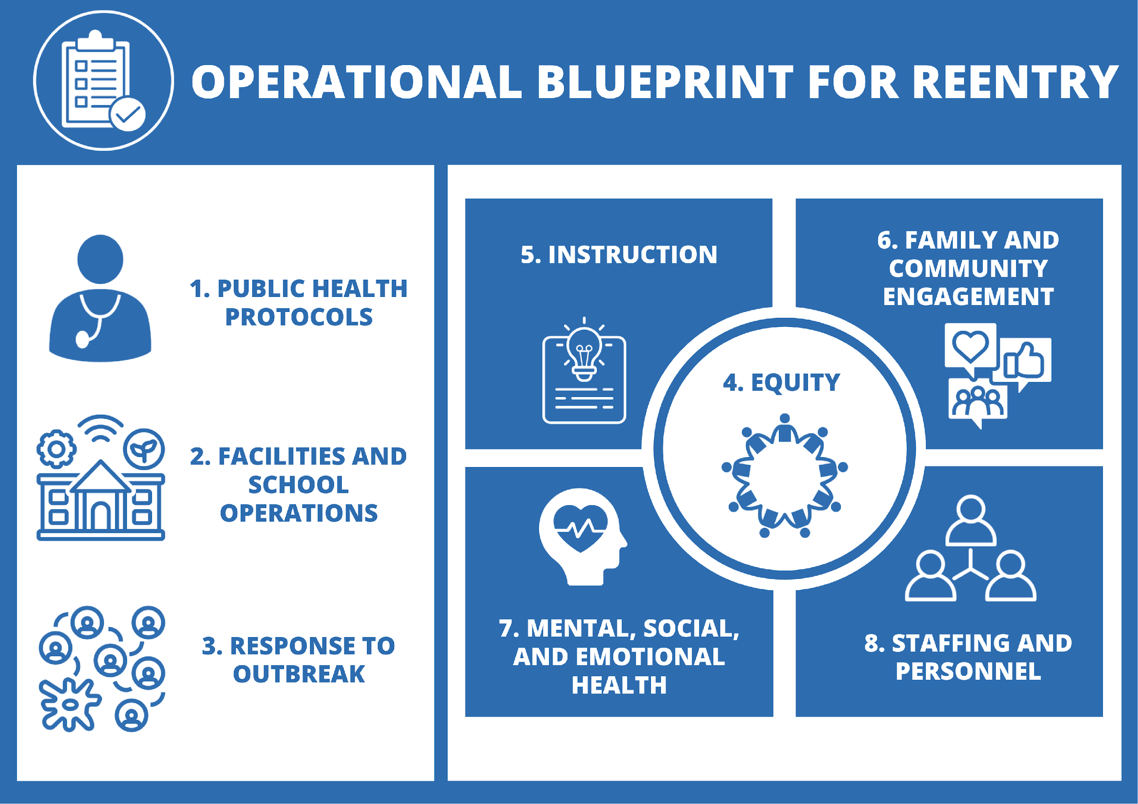
Operational Blueprint
Due no later than August 15th, 2020.
Notes:
left side tied to the operational blueprint plan required for each school

Slide 7
Critical Steps for Completing the Operational Blueprint for Reentry:
By August 15, 2020 or prior to the beginning of the 2020-21 school year, whichever is earlier, every school must complete an Operational Blueprint for Reentry.
Preparation
1. Read this Ready Schools, Safe Learners guidance in its entirety.
2. Consult your Local Public Health Authority and familiarize yourself with the disease management metrics within your health region.
3. Assemble appropriate personnel within the school/district and any community partners to create a planning team.
Plan Development
4. Work with the planning team to complete the Operational Blueprint template for your school. Private schools are required to complete sections 1-3.

Slide 8
Critical Steps for Completing the Operational Blueprint for Reentry
Plan Development (Continued)
5. Consult with key partners (see section six, including Tribal Consultation) to complete the Operational Blueprint for Reentry.
6. Submit the Operational Blueprint for Reentry to your local school board.
Public Health Review
7. Submit the Operational Blueprint for Reentry to your Local Public Health Authority.
8. Your Local Public Health Authority will attest to receiving the blueprint, carefully reviewing sections 1-3, and supporting your ongoing efforts towards ongoing COVID-19 mitigation efforts.
Final Plan Submission
9. Post the Operational Blueprint for Reentry on your school and district websites. If there is no school or district website, it can be posted to the ESD website.
10. Submit final plan for each school to the Oregon Department of Education.

Slide 9
Balancing Health and Safety with Educational Practices

Slide 10
Focus Requirements
To Get School Started
Notes:
To get started, there are a few key considerations for students being on campus. Once you have established these guardrails, the planning becomes easier for each area. We recomend starting with these six points as decision markers. Once district leaders have established key points for these six, school buidlings can more easily make plans for other logistical operations.

Slide 11
Grounding PRINCIPLES
for Reducing Potential Exposures
The mainstays of reducing exposure to the coronavirus and other respiratory pathogens are:
Physical distancing — minimizing close contact (<six feet) with other people.
Hand hygiene — frequent washing with soap and water or using hand sanitizer.
Cohorts — conducting all activities in small groups that remain together over time with minimal mixing of groups.
Protective equipment — use of face shields, face coverings, and barriers.
Environmental cleaning and disinfection — especially of high-touch surfaces.
Isolation of sick people and quarantine of exposed people.
With the above considerations foremost, outdoor activities are safer than indoor activities.
Notes:
Understanding the virus
like cigar smoke in a room
not strong on surfaces, easily cleaned
navigating the guidance
Continuum of risk

Slide 13
Community and Family Engagement
Key Concepts
A key step to your implementation plan is understanding what the family, community and students really need and want during a reimagined COVID-19 learning environment.
Key Next Steps
Gather relevant information from your student and parent groups
Consider collecting parent and student survey
Identify your key contacts and collect information

Slide 14
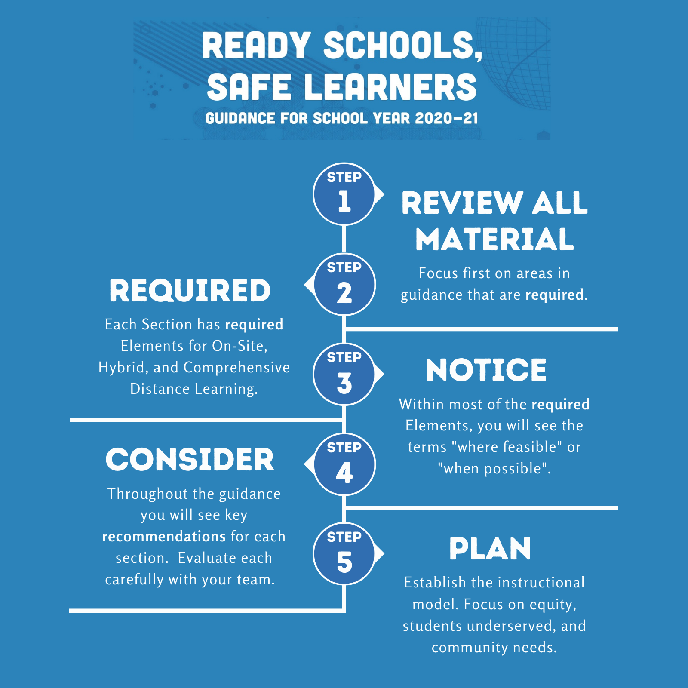
Operational Blueprint
Notes:
Notice each section has different elements
required, required and where feasible and when possible
and recommendations

Slide 15
Getting Started
Key Concepts
Each school building will complete a blueprint.
Every district is different, some decisions may be district level and some may be decisions you can make independently.
It is important to make connections early with transportation and meal service as they may impact your model choice.
Key Next Steps
Understand your decision making boundaries are in planning.
Download the blueprint and review the requirements of each section.
Consider who will be on your planning team and outline timelines for completion of the blueprint.
Make connections with key leaders in the district that will be integral in developing and implementing your school’s plan.

Slide 16
Communicable Disease Management Plan for COVID-19
While this is a district document the details in the plan can affect the implementation plan for the building.
As you balance the health and safety needs of your building implementation plan refer back to your communicable disease document to:
Ensure that high standards of health and safety are met
Maintain consistency between the communicable disease plan and your building implementation plan
Designate a person at each school to establish, implement and enforce physical distancing requirements, consistent with this guidance and other guidance from OHA.
Process and procedures to train all staff in sections 1 - 3 of this guidance. Consider conducting the training virtually, or, if in-person, ensure physical distancing is maintained.
Do I need to write my own protocols for the communicable disease plan?
Yes, in some cases there will be individual protocols written for each school
Example: Protocol for screening students and staff for symptoms, System for daily logs

Slide 17
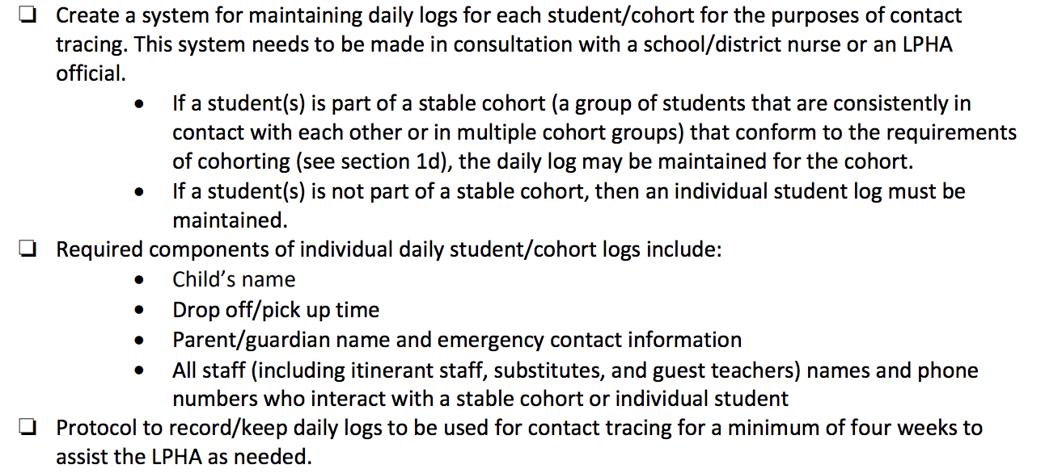
Required CDMP Components
Daily Logs

Slide 18
Note* This log template accounts for the CDMP requirements as well as visual screening.

Slide 19
More Communicable Disease Management Plan Requirements
Key Next Steps
As a district team:
Identify which protocols will be written and dictated by the district
Determine what protocols need to be written by buildings
Outline the protocols needed and assign team members

Slide 20
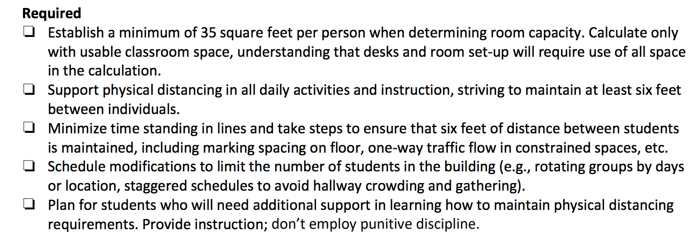
Physical Distancing

Slide 21
Physical Distancing
Room Capacity
Establish a minimum of 35 square foot per person to determine room capacity
Calculate only usable classroom space
Subtract cupboards, tables and non-student desks spaces
Strive to use all of the usable space in the room
In doing so, work to keep people’s work spaces 6 feet from each other
Key Next Steps
Measure and determine the number of people that can be in each classroom and common space
Consider placing a sign with the number of people up in each space so that people who enter the area understand if there are too many in the room
The number of people in a space will help drive your decision about the model you choose for the Fall
Notes:
35 square feet per student room capacity excluding unusable space (countertops, etc.)
Strive to maintain at least 6 feet between individuals at all times
Utilize strategies such as tape on flooring, or spray paint on grass to help students maintain distances
Plan for additional adult support

Slide 22
Physical Distancing
Minimizing Standing in Lines
List all the places in the building where students stand in lines and consider ways to adjust schedules
In areas where there will be time spent in lines take steps to ensure there is 6ft distance between students
Use signage to support physical distancing and proper flow of the building to avoid congestion
Marks on the floor signaling where to stand, one way traffic, separate entrance and exits etc.
Plan for students who will need training and support to follow these new requirements
Key Next Steps
List areas of congestion and standing in lines and work through adjustments
Develop plans for signage - order purchased items early, items are running out quickly
Add training for students on physical distancing to your list of back to school student and staff activities
Notes:
35 square feet per student room capacity excluding unusable space (countertops, etc.)
Strive to maintain at least 6 feet between individuals at all times
Utilize strategies such as tape on flooring, or spray paint on grass to help students maintain distances
Plan for additional adult support

Slide 23
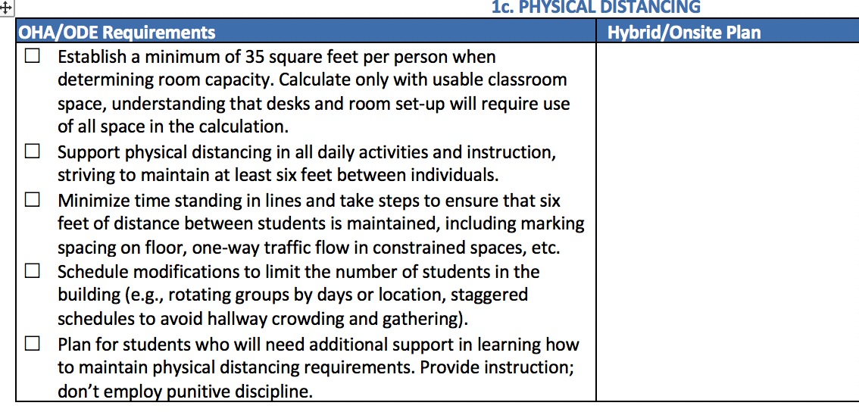
Physical Distancing
Critical Step – Plan Development
Describe your physical distancing plan on page 5 of the blueprint.
Indicate how you will address each of the required items.
Notes:
Operational Blueprint has four sections-
Sections 1-3:
Public Health related implementation
Sections 4-8:
Assurance that you are planning for equity, instruction, engagement, social/emotional/mental health, and staffing and personnel

Slide 24
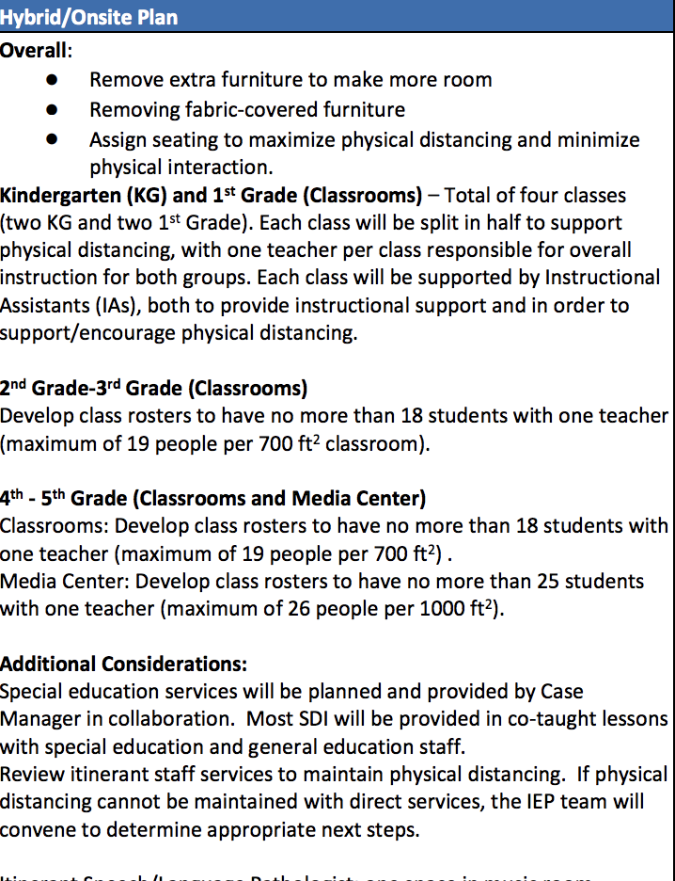

Slide 25
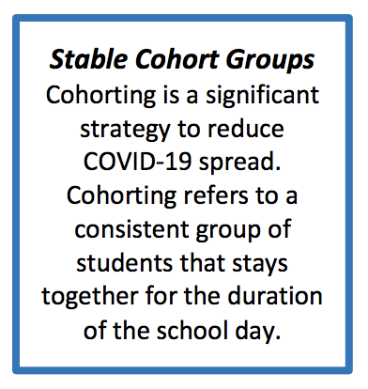
Stable Cohorts
Groups must maintain the 35 sq ft per person and striving for six feet requirement.
Minimize interactions between stable cohorts.
Weighing Risks
The smaller the cohort the less risk
The larger the cohorts and the more interaction between them increases risks
Cohorting
Notes:
TALKING POINTS - THE HOW?.... *See pp.39-40
Consider…
Collaborate with students, families, community-based organizations in planning.
Engage early in the process, build a collaborative partnership for moving forward, and plan for additional engagement opportunities to support the iterative development.
Elevate student voice in designing the educational spaces/experiences; inform decisions based on their voices and expertise as people very intimately involved in and familiar with the education process.

Slide 26
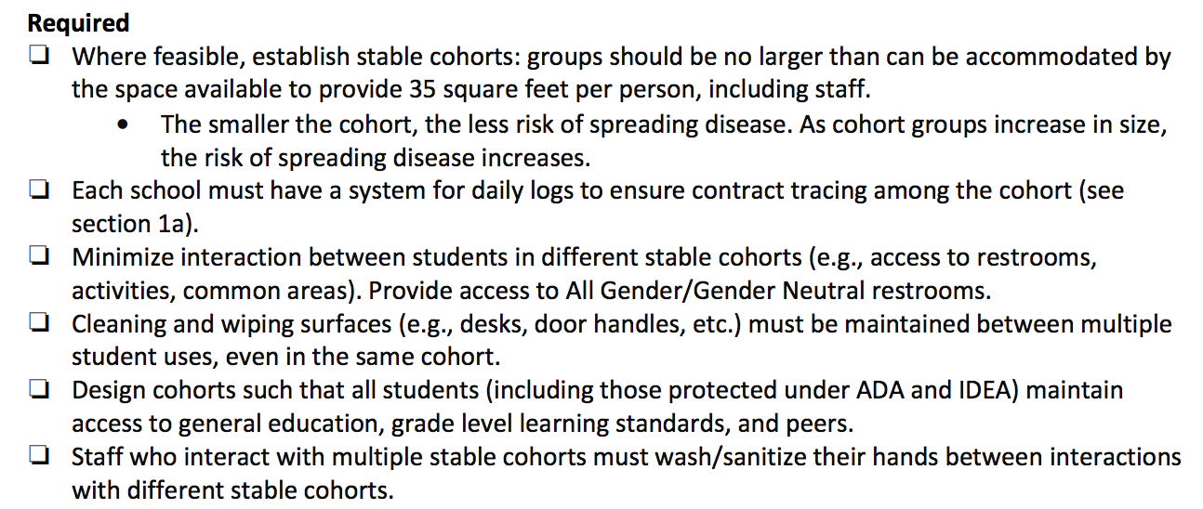
Cohorting

Slide 27
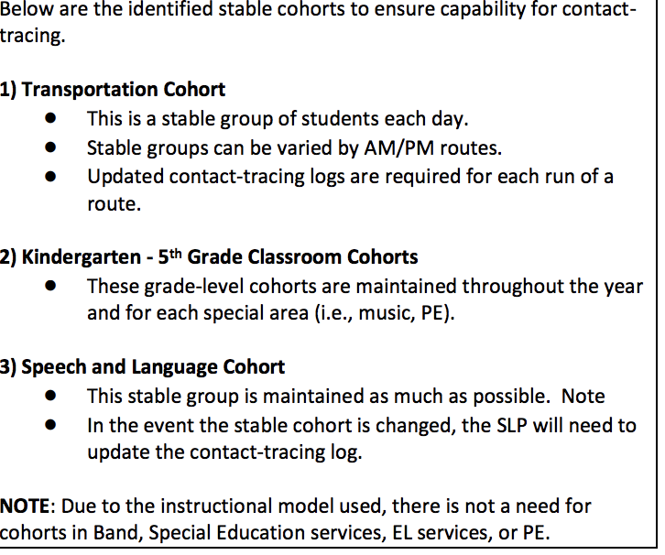
Notes:
SAMPLE - COLTON ELEMENTARY COHORTS

Slide 28
Cohorting
Mitigating Cohort Risks
Cleaning and wiping surfaces between cohort
Staff who interact with multiple cohorts must wash/sanitize hands between groups
Key Concepts
Design cohorts where all students maintain access to general education, grade level learning standards and peers
Students cannot be placed into a cohort groups based on any demographic or disability criteria
Notes:
TALKING POINTS - THE HOW?.... *See pp.39-40
Consider…
Collaborate with students, families, community-based organizations in planning.
Engage early in the process, build a collaborative partnership for moving forward, and plan for additional engagement opportunities to support the iterative development.
Elevate student voice in designing the educational spaces/experiences; inform decisions based on their voices and expertise as people very intimately involved in and familiar with the education process.

Slide 29
Entry and Screening
Key Concepts
All Schools will develop plans and procedures to ensure proper screening before students enter the building.
Each building should evaluate their physical layout, doorways and options for entering the building given physical distancing requirements
Evaluate available staff to conduct screenings and train them on the protocols
No person exhibiting primary symptoms will be admitted to the campus
Primary symptoms of concern: cough, fever or chills, shortness of breath, or difficulty breathing
Key Next Steps
Develop entry and screening protocols
Develop a training plan for screening for symptoms
Use your school nurse or contact your ESD for access to training supports
Follow all LPHA advice on restricting from school students or staff who have been exposed
Notes:
TALKING POINTS - THE HOW?.... *See pp.39-40
Consider…
Collaborate with students, families, community-based organizations in planning.
Engage early in the process, build a collaborative partnership for moving forward, and plan for additional engagement opportunities to support the iterative development.
Elevate student voice in designing the educational spaces/experiences; inform decisions based on their voices and expertise as people very intimately involved in and familiar with the education process.

Slide 30
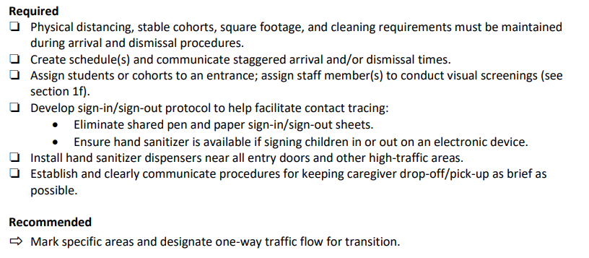
Arrival and Dismissal
Key Concepts
Arrival and dismissal times present specific challenges to maintaining health requirements (e.g., adequate physical distancing) that can be addressed through a variety of strategies, including:
Staggered arrival and dismissal schedules, and
Assigned entrances/exits.
Arrival and dismissal times should be kept as brief as possible.
Contact tracing logs must be kept during arrival/dismissal periods.
Key Next Steps
Develop arrival and dismissal procedures including assigned location for entry/exit
Communicate all procedures with staff, families, and students
Notes:
TALKING POINTS - THE HOW?.... *See pp.39-40
Consider…
Collaborate with students, families, community-based organizations in planning.
Engage early in the process, build a collaborative partnership for moving forward, and plan for additional engagement opportunities to support the iterative development.
Elevate student voice in designing the educational spaces/experiences; inform decisions based on their voices and expertise as people very intimately involved in and familiar with the education process.

Slide 31
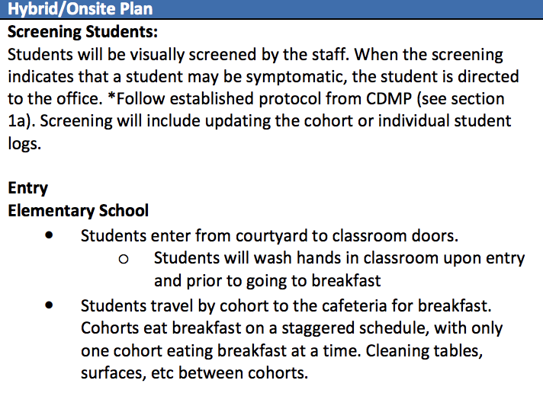

Slide 32
Reflect and Process
Attached in the participant agenda is a workbook, which may be helpful to guide your thinking. We are providing a few minutes for you to reflect on
Section 1 Requirements
Notes:
Consider the resources below…
The table below highlights several pitfalls and recommendations for educators seeking to implement SEL to make progress on equity and inclusion
Click here to download this chart as a reference tool.
In order for efforts aimed at developing the social emotional and academic development (SEAD) of students to advance educational equity, we must:
Situate our efforts in the historical, socio-political, and racialized context (white supremacy) of education in the United States.
Approach SEL work with the explicitly stated purpose of creating more equitable learning environments and outcomes (not as an afterthought or add-on).
Ensure that educators begin by developing their own self-awareness, social-emotional intelligence and cultural competence; understanding the cultural reference through which they understand themselves and their students, and surfacing and confronting the ways in which they may be, consciously or unconsciously, contributing to the racial vulnerability of their students.

Slide 33
Meal Service
Key Concepts
Students must wash their hands before meals and are encouraged to do so afterwards
Adequate cleaning measures must be performed including
Cleaning and sanitizing meal touch points
Cleaning of tables between meals/cohorts
Appropriate daily cleaning of meal items (plates, utensils, carts etc.)
Key Next Steps
Engage nutrition services in planning conversations
Identify the total number of people that can be in the meal service area using physical distancing requirements
Determine the best timing of meal service to students that will maintaining stable cohorts
Notes:
35 square feet per student room capacity excluding unusable space (countertops, etc.)
Strive to maintain at least 6 feet between individuals at all times
Utilize strategies such as tape on flooring, or spray paint on grass to help students maintain distances
Plan for additional adult support

Slide 34
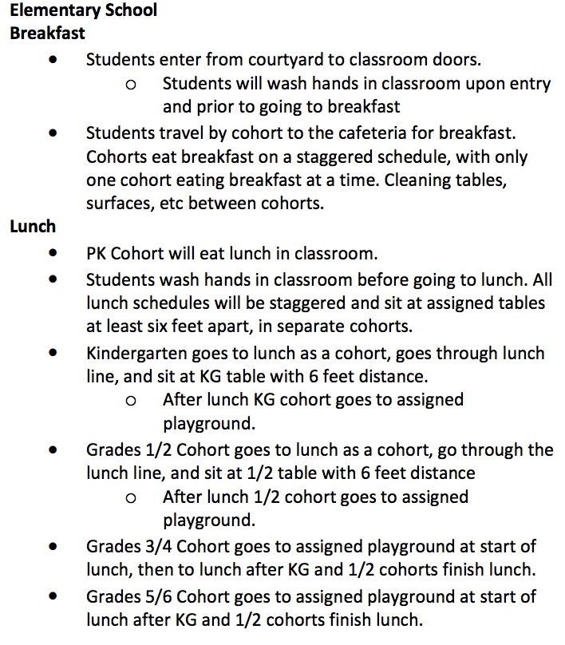

Slide 35
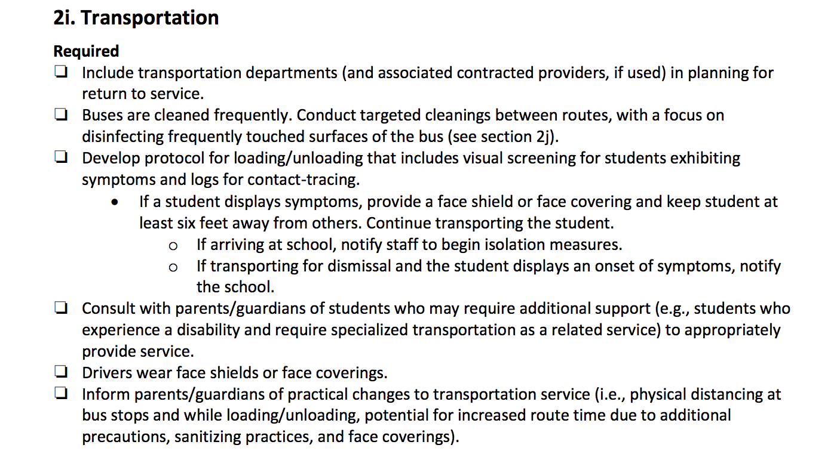

Slide 36
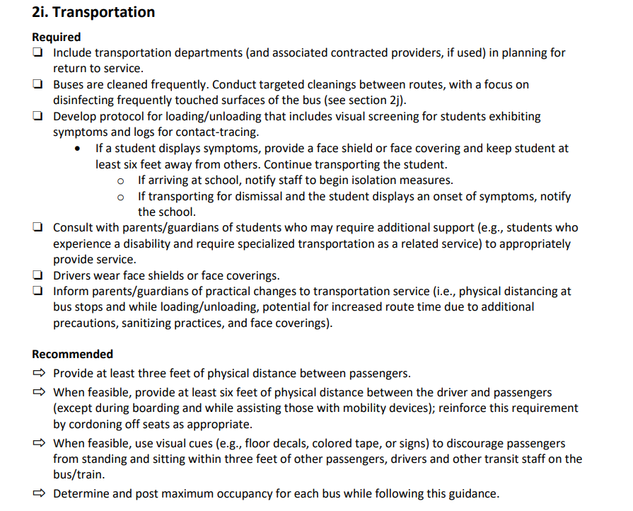
Transportation
Key Concepts
Transition from summer school guidance
Transportation is a cohort, but will likely interact with other cohort groups throughout the school day. Contact logs will be critical.
Drivers or bus staff will need to visually screen students, but are not to turn students away.
Working and communicating with families will be critical to successful transportation plans.
Key Next Steps
Work with transportation department it may impact model selection and it will affect other areas like arrival/dismissal.
Other areas to consider in transportation planning include: development of cleaning procedures, training of staff, determining bus capacity and seating arrangements

Slide 37
Communication & Training
Key Concepts
Understanding of the school’s plans will alleviate a lot of fears and anxiety about the upcoming school year. Be as open and transparent in the planning process as possible.
With all of the new requirements and procedures being established for the 2020-21 school year, adequate training will be required for all involved (i.e., staff, students, parents).
Key Next Steps
Validate people’s emotional responses to COVID-19 while assuring that plans are being made to keep staff, students, and families safe.
Work with your LPHA and other partners to establish communication and training protocols that will support implementation of your operational blueprint.

Slide 38
Communication & Training
District-wide Communication Strategy
All communications must be provided to multilingual families in a language they understand
Post The Blueprint for Reentry on the district website
Share the district and building plans with families prior to school starting
Next Steps
Develop a communication timeline
Communicate in multiple formats ensuring that you reach all school populations
Utilize key partners and affinity groups to assist in reaching all students and families

Slide 39
Reflect and Process
Attached in the participant agenda is a workbook, which may be helpful to guide your thinking. We are providing a few minutes for you to reflect on
Section 2 of the guidance document
Notes:
Consider the resources below…
The table below highlights several pitfalls and recommendations for educators seeking to implement SEL to make progress on equity and inclusion
Click here to download this chart as a reference tool.
In order for efforts aimed at developing the social emotional and academic development (SEAD) of students to advance educational equity, we must:
Situate our efforts in the historical, socio-political, and racialized context (white supremacy) of education in the United States.
Approach SEL work with the explicitly stated purpose of creating more equitable learning environments and outcomes (not as an afterthought or add-on).
Ensure that educators begin by developing their own self-awareness, social-emotional intelligence and cultural competence; understanding the cultural reference through which they understand themselves and their students, and surfacing and confronting the ways in which they may be, consciously or unconsciously, contributing to the racial vulnerability of their students.

Slide 40
Model Selection
Key Concepts
Schools can choose between three instructional models for the 2020-21 school year.
On Site and Hybrid models are preferred where possible.
Schools selecting Comprehensive Distance Learning must follow CDL guidance.
Local context will drive instructional model selection.
Instructional models may shift during the school year, based on local preference or evolving health needs. Short-Term Distance Learning may be needed due to outbreak.
Regardless of model, schools must meet each student’s mental, social and emotional health, and academic learning needs.
Key Next Steps
Determine if On-Site or Hybrid instruction can be offered in your school to start the 2020-21 school year.
If On-Site or Hybrid Learning is selected, begin planning for the possibility of Short-Term Distance Learning for one/a few, many, and all of your students in response to an outbreak.
If Comprehensive Distance Learning is selected, analyze and problem solve barriers to support eventual return to On-Site or Hybrid models.

Slide 41
Model Selection
Additional Considerations
Ensure that your model provides for equitable access to for all students.
On-Site and Hybrid models may need to shift rapidly and seamlessly to Short-Term Distance Learning (determined by LPHA or OHA).
There is no current waiver for instructional time hours - work towards providing as many hours as possible in your selected model.
Remember that some students may not be able to come back on-site and you will need to develop comprehensive and equitable instructional options for students who fall into this category.

Slide 42
Model Selection
Safeguarding Opportunities Clause
Remember that the safeguarding requirements from Distance Learning for All are still required to be implemented in the 20-21 school year.
Do not hold back or retain students due to impacts of the Spring 2020 closure
Do not limit opportunities for courses based on performance during Spring 2020 including, but not limited to, access to course sequence, grade promotion, placement in advance courses or access to extracurriculars
Develop a Credit-Earning Assurance Plan with students and families by September 2020 for any student who received an incomplete during the final term of 2020-2021
Notes:
Draft for High School Presentation

Slide 43
Model Selection
Higher Risk Instructional Activities
Courses that require hands-on, interactive and physical activities require additional health and safety measures
Physical Education, CTE, Labs and Performing Arts classes are critical to a well-rounded education but must be addressed carefully
Key Considerations
Carefully attend to section 1 of the guidance for these courses
Increase physical distance and reduce cohorts where possible
Follow equipment cleaning guidelines
Consider modifications to the learning experience, course or physical space to address health and safety concerns

Slide 44
Scheduling
Designing ways to provide stable cohorts in a traditional school model where students move from class to class throughout the day can be challenging.
Key Concepts
Consider mechanisms where students can participate in blocks of of classes together to maintain cohorts
Conversely think through how you might use A/B schedules or week on and week off scheduling etc. to reduce contact between cohorts and increase physical distancing.
In order to address the health and safety needs outlined in the guidance, think through ways where you can move away from the traditional system to more flexible delivery systems
Consider the contexts of your individual buildings and transportation/meal requirements as you develop your unique approach to providing instruction to students.

Slide 45
Planning a Flexible Master Schedule
We know that schools may need to shift models in response to outbreaks, but there is much about how this year will unfold that we still do not know.
The more flexibilities we can build into this school year, the more nimble we can be responding to unexpected circumstances.
The master schedule represents a significant structure and framework for how instruction is conceptualized within a campus.
Therefore, the more adaptable we can make a master schedule, the more responsive we can be in meeting all students’ needs.

Slide 46
“Robyn Bagley (@gallagherrobyn), Founder and former Principal of Career Path High, made sure that there was a blended and flexible schedule that did not have bells running students’ days. Students at Career Path are encouraged to work at their own pace and from any location. This allows for highly personalized learning, with success measured by course completion and not marked by a calendar deadline and time for internships and apprenticeships. While there are still Career Path Learning Center requirements, such as PBL collaboration, weekly success-coach meetings and interventions when needed, students truly have much more choice in their learning day.
At many schools, there is a push to eliminate bells and a rigid structure altogether. When interdisciplinary learning is the goal of a school, this flexibility can be crucial to sustained work on projects and collaboration.”
Source: https://www.gettingsmart.com/2017/02/scheduling-for-learning-not-convenience/

Slide 47
Scheduling for Learning, Not Convenience
There are 4 basic steps to schedule development 1:
Determine goals
Understand parameters
Select underlying structure
Incorporate flexibility
Much about goals and parameters are established by the Ready Schools, Safe Learners guidance.
These slides will share information about possible underlying structures and how these models can support flexibility in the 20-21 school year.
¹Source: https://www.gettingsmart.com/2017/02/scheduling-for-learning-not-convenience/

Slide 48
Some Secondary Scheduling Options
TRADITIONAL OR PERIOD SCHEDULE
Under a traditional schedule, students take six, seven, or eight periods a day throughout the entire school year.
Typically, each of these periods lasts between 45 and 55 minutes with approximately five minutes for moving between classes built into the daily schedule.
Students receive full credit for each of the classes they complete at the end of the school year.
This model is the simplest schedule in terms of staffing assignments, master schedule development, bussing, and lunch scheduling.
4X4 OR SEMESTER BLOCK SCHEDULE
A/B, OR ALTERNATING, BLOCK SCHEDULE
TRIMESTER BLOCK SCHEDULE
75‐75‐30 BLOCK SCHEDULE
The next several slides take information from:
Optimal Scheduling for Secondary School Students and Scheduling for Learning, Not Convenience.
Notes:
CONSIDER GOING FAST AND LINKING RESOURCE

Slide 49
Secondary Scheduling Options
TRADITIONAL OR PERIOD SCHEDULE
4X4 OR SEMESTER BLOCK SCHEDULE
The 4x4 block schedule divides the school year into two semesters. Students take half of their eight courses during the first semester and the other half during the second semester.
Under a 4x4 block schedule, instructional time for each course is generally between 85 and 100 minutes per day, allowing students to theoretically accomplish in one semester what would take them a whole year under a traditional schedule. Figure 1.1 compares course time under a 4x4 schedule with course time under a traditional schedule.
A/B, OR ALTERNATING, BLOCK SCHEDULE
TRIMESTER BLOCK SCHEDULE
75‐75‐30 BLOCK SCHEDULE

Slide 50
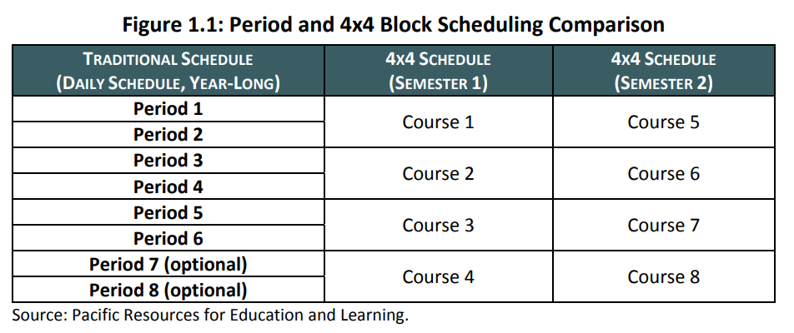

Slide 51
Secondary Scheduling Options
TRADITIONAL OR PERIOD SCHEDULE
4X4 OR SEMESTER BLOCK SCHEDULE
A/B, OR ALTERNATING, BLOCK SCHEDULE
The A/B block schedule divides six or eight blocks of classes between two alternating days so that students only take three or four courses a day.
Under the A/B schedule, classes last between 85 and 100 minutes, and students receive credit for their courses at the end of the academic year.
TRIMESTER BLOCK SCHEDULE
75‐75‐30 BLOCK SCHEDULE

Slide 52
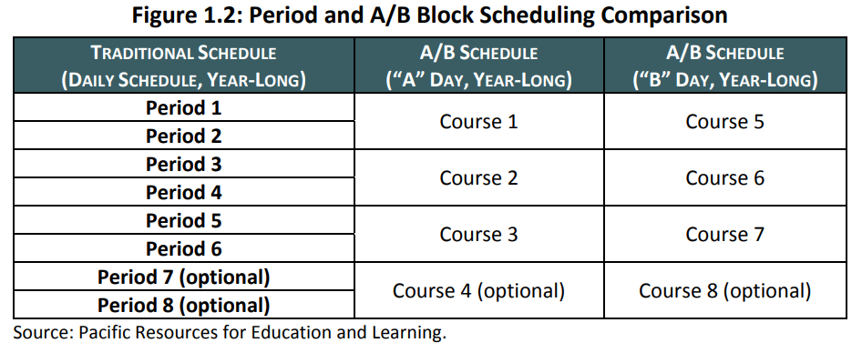

Slide 53
Secondary Scheduling Options
TRADITIONAL OR PERIOD SCHEDULE
4X4 OR SEMESTER BLOCK SCHEDULE
A/B, OR ALTERNATING, BLOCK SCHEDULE
TRIMESTER BLOCK SCHEDULE
The trimester block schedule, or the 3x5 trimester model divides the year into three 12‐week terms with five, 70 minute class periods per day.
Students take the same classes every day during the term and earn 0.5 credits per class per trimester.
The model is somewhat unique because it claims many of the advantages typically associated with both traditional and block schedules
75‐75‐30 BLOCK SCHEDULE

Slide 54
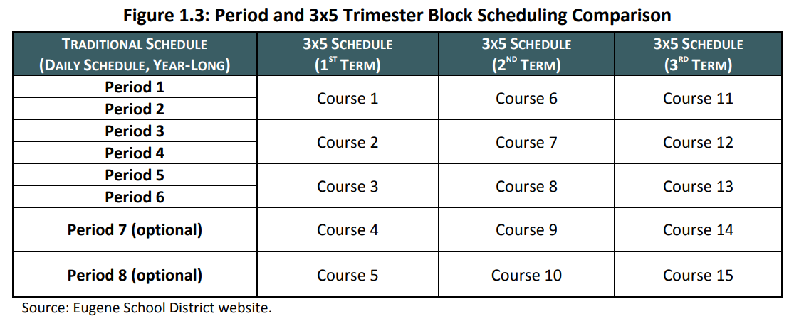

Slide 55
Secondary Scheduling Options
TRADITIONAL OR PERIOD SCHEDULE
4X4 OR SEMESTER BLOCK SCHEDULE
A/B, OR ALTERNATING, BLOCK SCHEDULE
TRIMESTER BLOCK SCHEDULE
75‐75‐30 BLOCK SCHEDULE
Under the 75‐75‐30 schedule, the school year is reconfigured to two 75‐day terms (a fall and winter term) and one 30‐day, intensive term at the end of the school year.
Students take three separate courses during the 75‐day term of approximately 120 minutes each.
The intensive term can be divided into two 15‐day terms with one class each or one 30‐day term with two classes. Naturally, these classes tend to be longer than 120 minutes. The last term or terms can be used by teachers to review key concepts with students, for students to make up school work missed during the longer terms, or for students to take electives or more advanced core subjects.

Slide 56
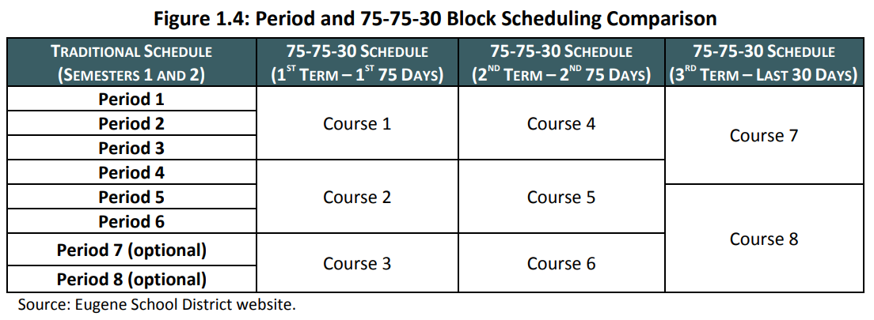

Slide 57
Characteristics of Flexible Schedules
1
Work Sessions
Big chunks of time for students to work on interdisciplinary projects are crucial.
2
Less Rigidity
The bell cannot be an inhibitor to student creativity.
Schools ought to try to find ways to encourage students to persist when they are in the middle of a task or challenge and not penalize them for being late to another in those circumstances.
3
Time for Multi-Use Spaces
Often, spaces that house power tools, 3d printers or even just the latest computers are not omnipresent throughout a school and are located in 2-3 rooms. These learning spaces need to be used freely and frequently.
Schedules that promote active learning ensure that multi-use spaces are used often and are seen as places that students can go to when it makes sense in their respective projects or assignments–not “only when it fits in the schedule.”
4
Advisory
Advisory is key to personalizing the secondary experience for students.
By the time students get to middle school, many already feel that they don’t have a true course or path, nor do they have the support to help them find and navigate their way–enter strong advisory.
A key function of the advisor is to ensure that every student has someone “who knows them well and supports them at school meetings and conferences.

Slide 58
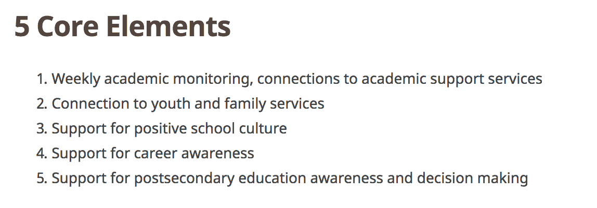
Core Elements of Advisory

Slide 59
Model Scenarios
on Transmission and Spread
https://ies.ed.gov/ncee/edlabs/regions/midatlantic/pdf/ReopeningPASchools.pdf
Notes:
The following info was taken from PA opening schools. It describes scenarios for HS and simulated models that are important to consider in balancing opening and instruction with health and safety. Scenario A is the baseline without reopening schools, the next scenarios describe schedules with simulated rates for each choice for high school schedule.

Slide 60
The model you select will directly relate to the exposure risks. Understanding how your model allows for potential transmission will help you determine the best approach for your district.
Notes:
Scenario A is baseline

Slide 61
Transmission Scenarios
Transmission Rates
The percentage of transmissions occurring within the school decreased from between 61 and 68 percent in Scenarios A and B
In scenario C they decreased to 50 and 43 percent
Notes:
Scenario A is baseline

Slide 62
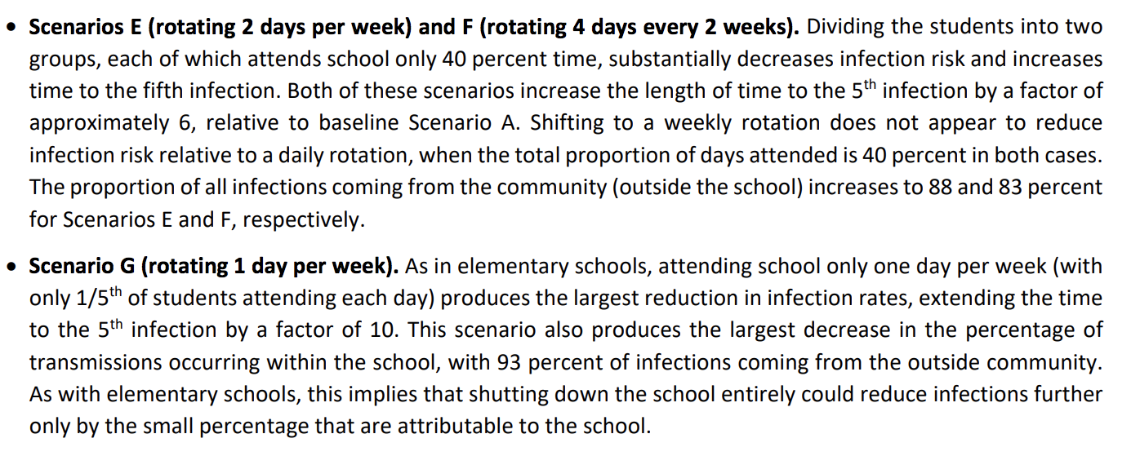
Transmission Scenarios

Slide 63
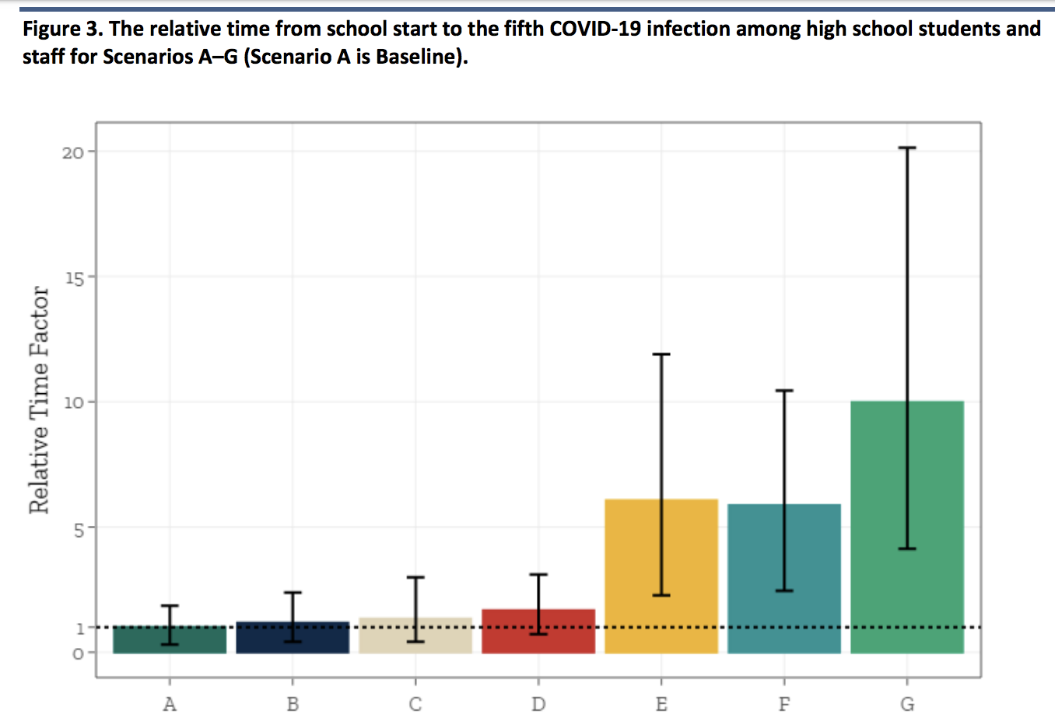
Notes:
The scenario model shows infection rates simulated for each HS model

Slide 64
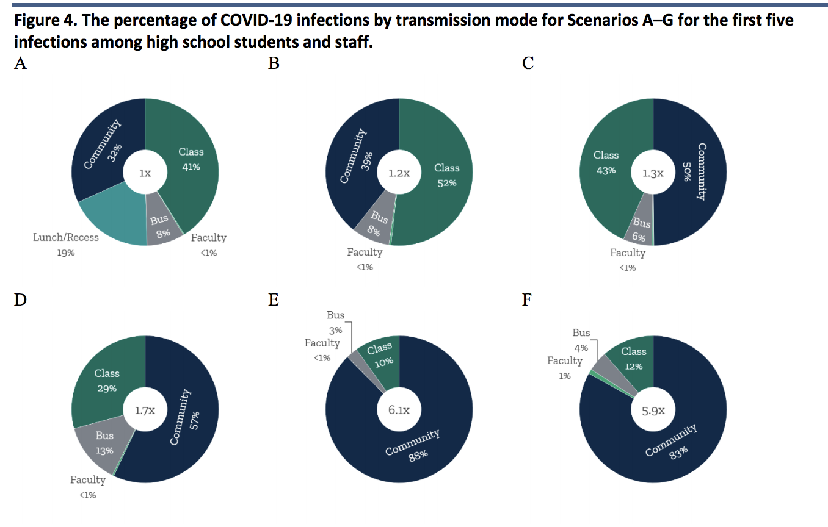
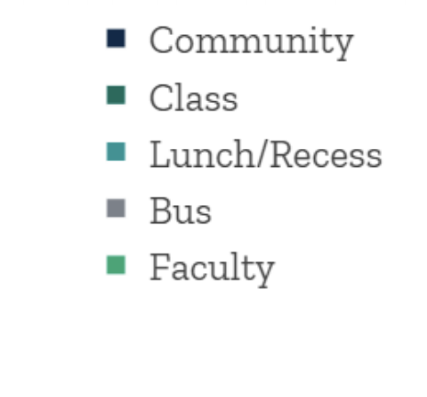

Slide 65
Mitigating Measures

Slide 66
Notes:
https://attachment.eab.com/wp-content/uploads/2020/05/Return-to-Learn-Webinar-May-28.pdf

Slide 70
Face Coverings and Shields
Staff
❏ Face coverings or face shields for: Staff who are regularly within six feet of students and/or staff
Staff who will sustain close contact and interactions with students. Bus drivers. Staff preparing and/or serving meals.
❏ Face shields or clear plastic barriers for: Speech Language Pathologists, Speech Language Pathology Assistants, or other adults providing articulation therapy and Front office staff.
❏ Face coverings for staff who interact with multiple cohorts
Students
❏ Face coverings recommended for grades 6-12.
❏ Students who choose not to wear face coverings must be provided access to instruction.
Notes:
TALKING POINTS - THE HOW?.... *See pp.39-40
Consider…
Collaborate with students, families, community-based organizations in planning.
Engage early in the process, build a collaborative partnership for moving forward, and plan for additional engagement opportunities to support the iterative development.
Elevate student voice in designing the educational spaces/experiences; inform decisions based on their voices and expertise as people very intimately involved in and familiar with the education process.

Slide 71
Face Coverings and Shields
Key District Actions
District plan to adhere to face/coverings and shields
Key Building Actions
Read and understand the requirements
Support staff with protective barriers when necessary
Notes:
TALKING POINTS - THE HOW?.... *See pp.39-40
Consider…
Collaborate with students, families, community-based organizations in planning.
Engage early in the process, build a collaborative partnership for moving forward, and plan for additional engagement opportunities to support the iterative development.
Elevate student voice in designing the educational spaces/experiences; inform decisions based on their voices and expertise as people very intimately involved in and familiar with the education process.

Slide 72
Cleaning, Disinfection & Ventilation
Key District Actions
Clean, sanitize and disinfect frequently touched surfaces
Increase ventilation and/or consider using outdoor spaces where feasible
Maintain physical distance
Maintain stable cohorts
Key Building Actions
Include licensed and experienced health staff on your planning team
Work closely with maintenance and facilities staff on cleaning protocols
Provide for frequent review of practices and procedures in your ongoing implementation and review processes
Notes:
TALKING POINTS - THE HOW?.... *See pp.39-40
Consider…
Collaborate with students, families, community-based organizations in planning.
Engage early in the process, build a collaborative partnership for moving forward, and plan for additional engagement opportunities to support the iterative development.
Elevate student voice in designing the educational spaces/experiences; inform decisions based on their voices and expertise as people very intimately involved in and familiar with the education process.

Slide 73
Series Four
Working with your ESDs
ESDs will provide ongoing information and planning supports. They will be acting as liaisons between districts and ESDs, working to ensure that schools have the supports they need to develop their Operational Blueprints. ESDs will be reaching out to districts soon with more information about future workshops.
Many Thanks to Design Team Members
Reach out to to them and your Regional Advisors
Candace Pelt, ODE * Alexa Pearson, ODE * Krista Parent, COSA
Angie Kautz, Clackamas ESD
Angela Hubbs, Multnomah ESD
Renae Iversen, Northwest Regional ESD
Amber Eaton, Oregon Association ESDs
Carlos Sequeira, Lane ESD
Gary Peterson, Oregon Association ESDs
Larry Glaze, InterMountain ESD
Janet Terry, Willamette ESD
Mark Redmond, Malheur ESD
Tenneal Wetherell, South Coast ESD

Slide 74
Group Norms
Share Air Time
Be Action-Oriented
Fill Gaps in Understanding
Share Ideas and Resources
Breakout Groups
Group 1 (main room): Guidance Deep-Dive | Group 2 (breakout room): Operational Blueprint
What are your lingering questions about sections 1-3 and the rest of the guidance document? And/or if you have some areas you’ve already thought through, share your ideas with the group. | In looking at question 2 of the Operational Blueprint, what are your thoughts/ideas around family and community engagement? Question 3: what model(s) are you considering and what are some of your wonderings about those models? What are some of your promising ideas and/or challenges for the requirements of sections 1-3?
Notes:
45 minutes in breakout groups, two choices, divide into groups considering the number of facilitators you have for breakouts.

Slide 75
Questions?
Notes:
Colt

